Slide 1
Android Programming
Mobile Development
Dr Ian Drumm

Slide 2
Getting Started
Aims:
Getting started with Android Development
Learning Outcomes:
The Activity Class
Widgets The View class
Layout managers and The ViewGroup class
Hello World!

Slide 3

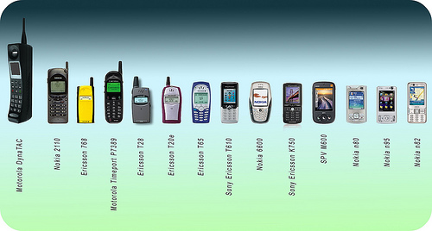
Early Mobile Phones
Screen Real-estate
Latency
Standards

Slide 4
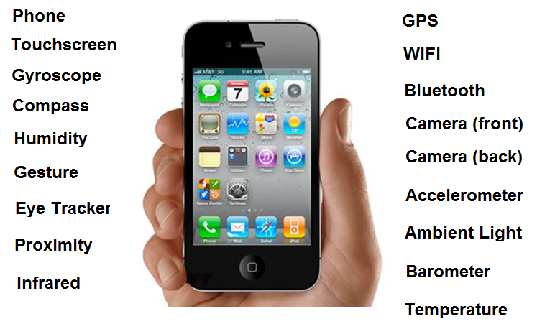
The Smart Phone

Slide 5


Open Handset Alliance
84 companies
Developed Android as first open and free mobile platform

Slide 6
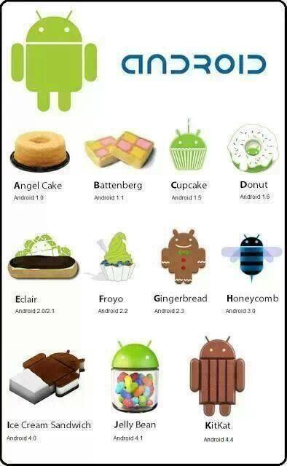
Based on Linux Kernel
Android Open Source Project
Numerous API versions
Google Play

Slide 7
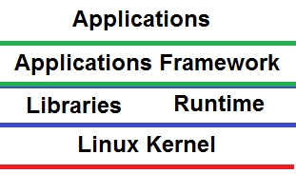
Android Software Stack
Classes and Services for the Apps
Dalvik/ART
Device Drivers and
Power Management
Core C/C++ Libraries
libc, SQLite, OpenGLES

Slide 8
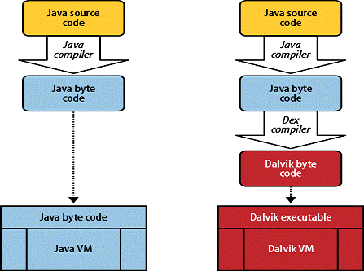
Android Runtime Environment
Android applications are developed in Java
Dalvik is the virtual machine that is used by Android
Though not JVM
Android SDK translates java bytecode to dalvik bytecode (Just in time compilation)
ART is a new Android runtime being introduced experimentally in the 4.4 release (Ahead of time compilation)

Slide 9

Android
Android Package File (.apk)
An .apk file contains all of that program's code (dex files), resources, assets, certificates and manifest file.

Slide 10

Android Studio
For writing source code, compiling, packaging, deploying and starting app on real or virtual devices
Android Studio is the official IDE for Android application development, based on IntelliJ IDEA.
Includes the OpenJDK (Java Development Kit) and Android SDK (Software Development Kit)
http://developer.android.com/tools/studio

Slide 11
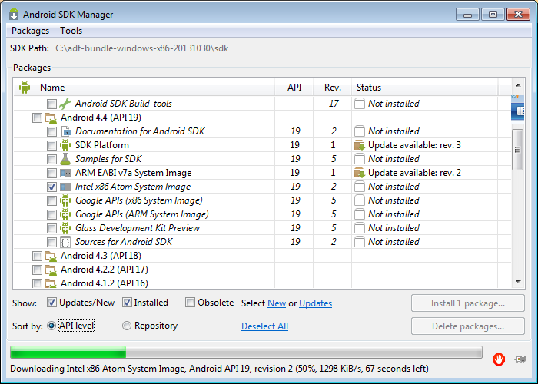
Android SDK Manager
Android SDK Manager from Android Studio
Can install packages for desired versions

Slide 12
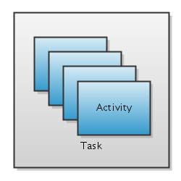
The Activity Stack
When a new activity is started, it is placed on the activity stack
Becomes the current running activity

Slide 13
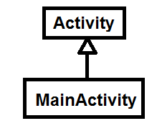
The Activity class
Activity class takes care of creating a window for you in which you can place your UI.
You subclass activity to create your application

Slide 14
The Activity class
Start your code by overriding the Activity class’s onCreate method
public class MainActivity extends AppCompatActivity {
@Override
protected void onCreate(Bundle savedInstanceState) {
// start code here ….
}
}

Slide 15
Activity’s Methods
public class Activity extends ApplicationContext {
protected void onCreate(Bundle savedInstanceState);
protected void onStart();
protected void onRestart();
protected void onResume();
protected void onPause();
protected void onStop();
protected void onDestroy();
}

Slide 16
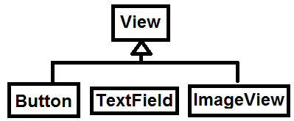
The View class and Widgets
Subclasses of the android.view.View class define user interface widgets, e.g., buttons, text fields, etc.
Widgets are instances of View’s subclasses
They have attributes to configure appearance and behaviour

Slide 17
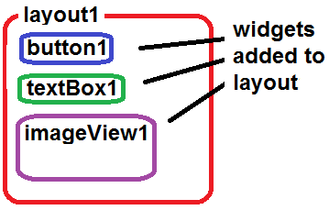
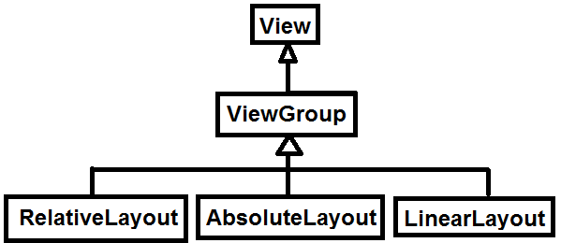
The ViewGroup class and Layout Managers
You add widgets to layouts, which are themselves widgets
Layouts can be nested within layouts.
The subclasses of android.view.View.ViewGroup define layouts (e.g. LinearLayout, AbsoluteLayout, etc)
Layouts are instances of ViewGroup’s subclasses

Slide 18
Set Content View
You set the root layout with
Widgets and Layouts can be declared instantiated in Java code
They can also be declared and instantiated from XML and associated with Java via their ids (see later)
setContentView(your_layout);

Slide 19
Hello World
public class MainActivity extends AppCompatActivity { LinearLayout myLayout; TextView myTextView; @Override protected void onCreate(Bundle savedInstanceState) { super.onCreate(savedInstanceState); myLayout=new LinearLayout(this); myTextView=new TextView(this); myTextView.setText("Hello world from Java"); myLayout.addView(myTextView);
setContentView(myLayout); } }

